Slide 1
NCDOT Usage of CMF Clearinghouse for CRF’s
Shawn A. Troy, PE
December 13, 2012

Slide 2
Historical Perspective
N.C. Department of Transportation
Crash Reduction Factors
  Began using CRF’s in the early 2000’s to justify projects using B/C
  Formed a committee, reviewed known research, and selected CRF’s to use on a statewide basis in our 8 Regional Traffic Safety Offices
  Who is on the committee?
  Why do we do this?
  CRF’s in April 2005 36 countermeasures
  CRF’s in May 2007 47 countermeasures
  CRF’s in October 2010 112 countermeasures
  CRF’s in November 2012 146 countermeasures
CRF = (1-CMF)*100

Slide 3
NCDOT CRF Selection Process
N.C. Department of Transportation
Crash Reduction Factors
  Option 1:
    CRF value is requested for a countermeasure where a CRF does not exist on our current listing by a Regional Traffic Engineer
    The CMF Clearinghouse is reviewed to see if a Quality CMF exists
    If no Quality CMF exists, the committee votes on a CRF to use until a value is available in the CMF Clearinghouse
  Option 2:
    On a 6 month to 12 month basis, we complete a mass download of the CMF Clearinghouse
    We review the latest CRF from this download and determine if they should be added to our CRF sheet

Slide 4
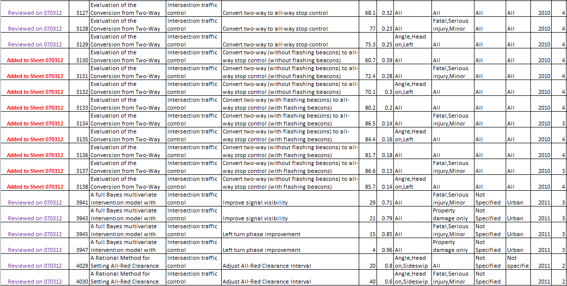
CMF Clearinghouse Mass Download
N.C. Department of Transportation
Crash Reduction Factors

Slide 5
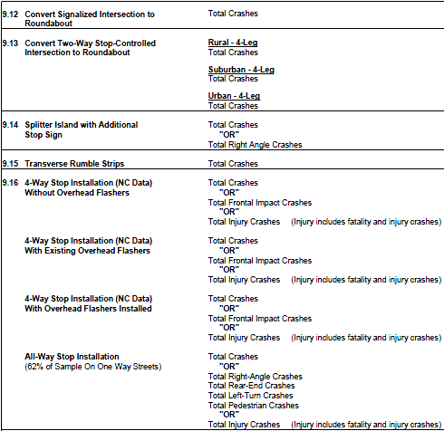
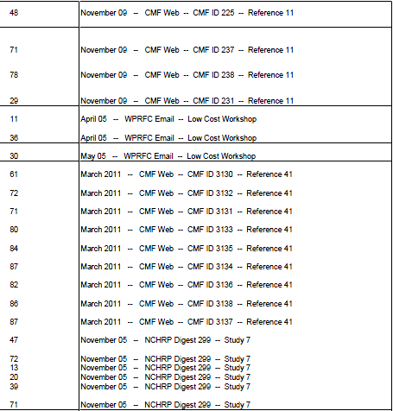
NCDOT CRF Sheet
N.C. Department of Transportation
Crash Reduction Factors

Slide 6
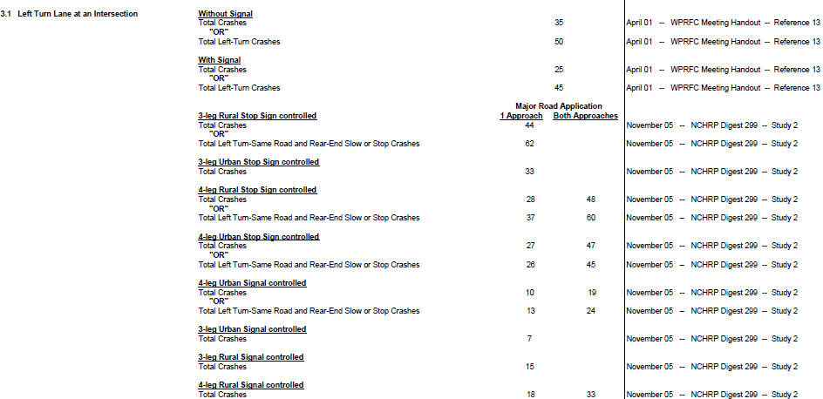
CRF Variability within Countermeasure
N.C. Department of Transportation
Crash Reduction Factors

Slide 7
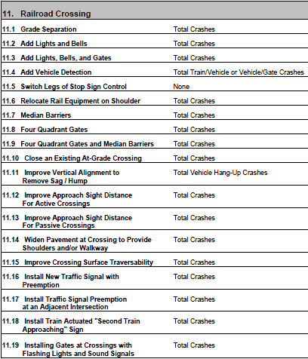
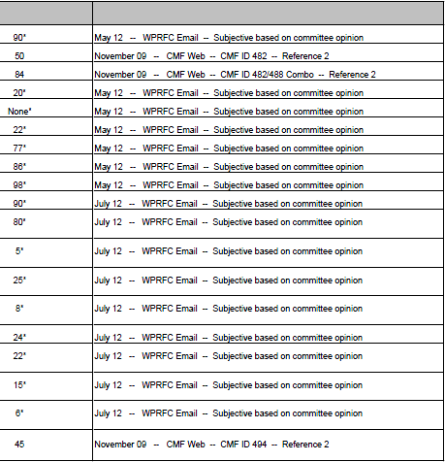
“Objective” versus “Subjective”
N.C. Department of Transportation
Crash Reduction Factors

Slide 8
Additional Information
N.C. Department of Transportation
Crash Reduction Factors
  Goal for us was to have an ACCOUNTABLE and DEFENDABLE process
  Recently updated the NCDOT CRF list in November 2012
  Will be willing to share information from November update:
    our CRF listing (.pdf file)
    our notes file from the downloaded CMF Clearinghouse (excel file)
    our notes file from the pre-CRF listing decision process (excel file)
  Send me an email request for this data or feel free to call

Slide 9
NCDOT Usage of CMF Clearinghouse for CRF’s
QUESTIONS?
Shawn A. Troy, PE
December 13, 2012
stroy@ncdot.gov
919-773-2897

